Slide 1

Replacing a cloud based computation tool on DrBoxOnline.com with faster running neural network

Slide 2
Section Instructor
Group members
Jigang Wu
Keye Chen
Yanzhuo Cao
Shuo Deng
Fengyu Zhang
Yukuan Zhu
Sponsor
Shane Johnson

Slide 3
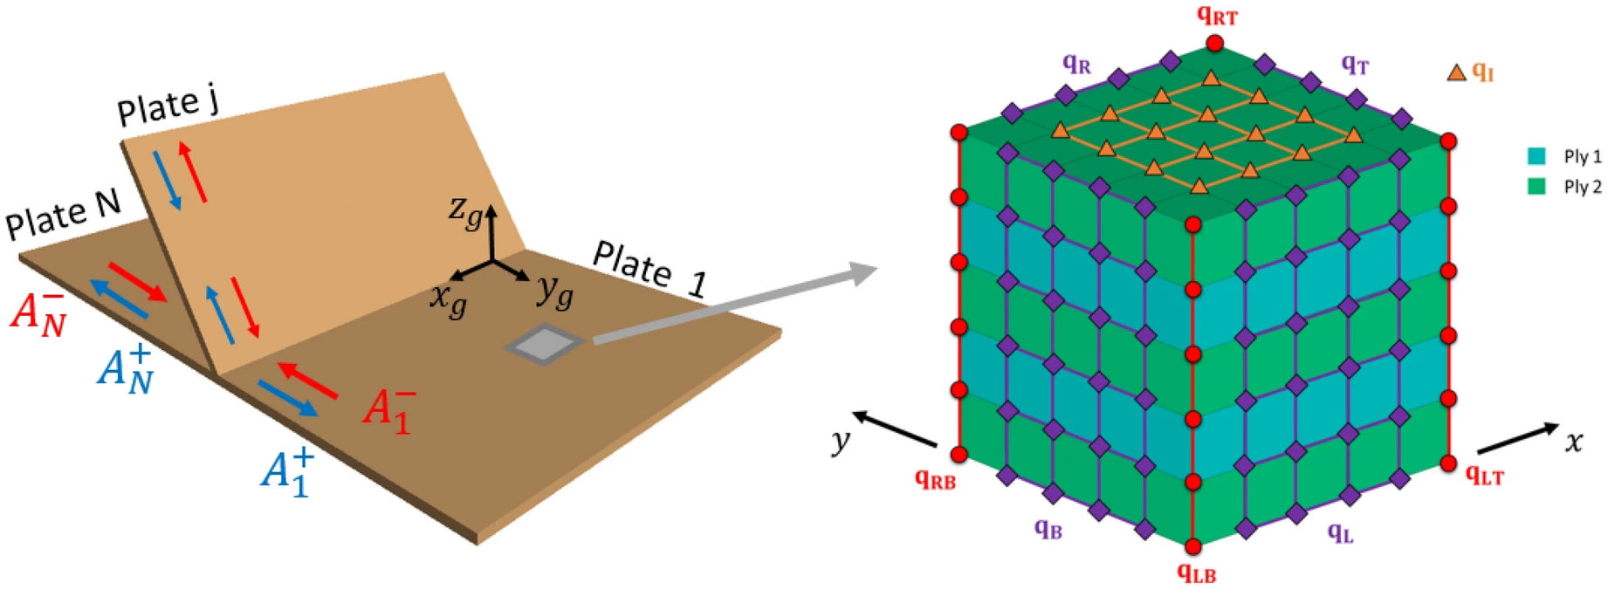
Problem Review: Predicting the Performance of Paper Boxes
Introduction
Corrugated Paper Boxes: Widely used for packaging and logistics due to their lightweight, recyclable, and customizable properties.
Problem: Prone to buckling during storage and shipment, causing:
Product damage
Lost revenue
Wasted resources
Customer complaints
Current Solution:
Dr. Box Calculator Pro
a website providing users with an interface to predict the box’s performance given certain information
Uses Finite Element Analysis (FEA) to predict buckling strength.
input dimensions, types and output force, deformation and failure of nodes in the meshes
Finite Element Analysis (FEA)
Definition: A numerical method for predicting how a product reacts to real-world forces, vibrations, heat, and other physical effects.
Process: Divides a complex problem into smaller, simpler parts (finite elements) and solves them.
Limitation: Time-consuming and requires extensive computational resources.
Notes:
Our project is closely related to the packaging and logistics industry: corrugated paper boxes. These boxes are widely used due to their lightweight, recyclable, and customizable properties. However, they are prone to buckling during storage and shipment, which can lead to product damage, lost revenue, wasted resources, and customer complaints.
To address this issue, the current solution in place is the Dr. Box Calculator Pro, a website that provides users with an interface to predict the box's performance using Finite Element Analysis (FEA). FEA is a numerical method for predicting how a product reacts to real-world forces, vibrations, heat, and other physical effects. However, FEA has its limitations - it is time-consuming and requires extensive computational resources.

Slide 4
Problem Review: Deep Neural Networks (DNN)
Proposed Solution
Deep Neural Networks (DNN): Replace FEA with DNN in Dr. Box Calculator Pro for faster and more efficient predictions.
Deep Neural Networks (DNN)
Definition: A Deep Neural Network (DNN) is an artificial neural network with multiple layers between the input and output layers, allowing it to model complex non-linear relationships.
Advantages:
Feature Learning: DNN automatically learn features from raw data, eliminating the need for manual feature extraction.
Scalability: DNNs can handle large-scale data and complex models, making them suitable for big data applications.
End-to-End Learning: DNN can learn directly from input to output, simplifying the pipeline by reducing the need for intermediate steps or separate models.
Benefits
Speed: Instant predictions of buckling strength.
Efficiency: Lower computational costs and faster analysis.
Scalability: Capable of handling diverse box types and conditions.
Notes:
This is where our proposed solution comes in: Deep Neural Networks (DNN). DNNs can replace FEA in the Dr. Box Calculator Pro for faster and more efficient predictions. DNNs are artificial neural networks with multiple layers between the input and output layers, allowing them to model complex non-linear relationships. They offer advantages such as feature learning, scalability, and end-to-end learning.
By using DNNs, we can achieve instant predictions of buckling strength, lower computational costs, faster analysis, and the ability to handle diverse box types and conditions. This means improved efficiency and effectiveness in packaging and logistics operations.

Slide 5
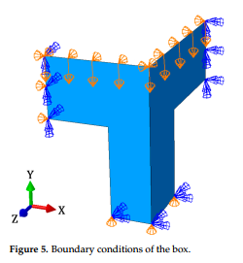
Literature Review 1: Numerical and Experimental Analysis of Corrugated Cardboard Boxes [1]
Overview
Objective: To predict the compression force of cardboard boxes considering various cutout configurations on the sidewalls.
Materials Used: Single-wall B-flute corrugated cardboard with specific components for outer liner, fluting medium, and inner liner.
Methods
Experimental Setup:
Conducted Box Compression Tests (BCT) under controlled humidity and temperature.
Numerical Model:
Utilized Abaqus FEA software.
Modeled only 1/8 of the box to simplify the analysis.
Applied homogenized linear elastic orthotropic material models with Hill plasticity.
Conducted buckling analysis to determine the mode of global imperfections.
Use the above result in compression tests.
Key Findings
Achieved high accuracy in predicting compression force from BCT with variations for different cutout rates.
Proved that numerical model can effectively replicate experimental results, though accuracy decreases slightly at higher cutout rates.
Figure 1. Boundary Conditions
[1] Fehér, Lajos, et al. "Compressive Strength of Corrugated Paperboard Packages with Low and High Cutout Rates: Numerical Modelling and Experimental Validation." Materials, vol. 16, no. 6, 2023, p. 2360, https://doi.org/10.3390/ma16062360.
Notes:
In the study by Fehér et al., the compressive strength of corrugated cardboard boxes with different cutout rates was analyzed using the finite element method (FEM). Their model used a homogenized linear elastic orthotropic material model with Hill plasticity, simulating one-eighth of the box to capture load-bearing behaviors and potential imperfections effectively. This method was validated against extensive experimental data, ensuring its reliability for predicting box failure under compressive loads.

Slide 6
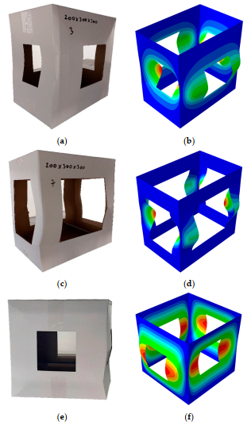
Literature Review 1: Numerical and Experimental Analysis of Corrugated Cardboard Boxes
Innovative Integration
Combines ANN with FEA: Utilizes neural networks to enhance the prediction of buckling strength, improving on traditional FEA limitations.
Advantages Over Traditional Methods
Increased Accuracy: Integrating ANNs with FEA improves prediction precision over traditional methods, especially in complex scenarios with varied cutout rates and designs.
Faster Simulations: ANNs expedite the analysis process, providing rapid evaluations and significantly reducing simulation times compared to conventional FEA.
Greater Flexibility: Our hybrid approach adjusts effortlessly to different box materials and designs, enhancing adaptability and scalability in packaging solutions.
Future Prospects
Broad Application: Suitable for diverse packaging needs, ensuring robust, efficient, and accurate design and analysis.
Cost-Effective: Reduces the need for extensive physical prototyping, lowering development costs and accelerating production cycles.
Figure 2. Numerical Analysis
[1] Fehér, Lajos, et al. "Compressive Strength of Corrugated Paperboard Packages with Low and High Cutout Rates: Numerical Modelling and Experimental Validation." Materials, vol. 16, no. 6, 2023, p. 2360, https://doi.org/10.3390/ma16062360.
Notes:
Our project builds on this by integrating artificial neural networks (ANNs) with finite element analysis, enhancing both the accuracy and efficiency of predictions. ANNs allow for quicker evaluations and can handle complex data relationships better than traditional FEM, offering faster simulations and adaptable solutions across different box types and materials.

Slide 7
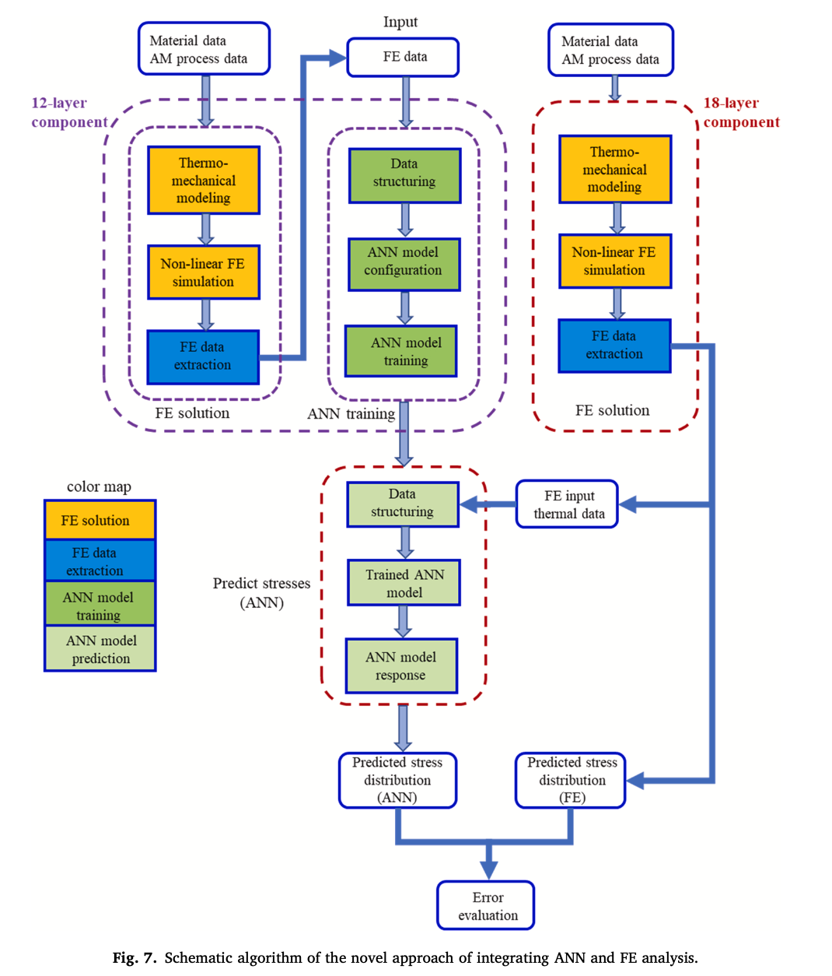
Literature Review 2: Integration of artificial neural network with finite element analysis for residual stress prediction of direct metal deposition process [2]
Overview
Objective: The primary objective is to develop a novel ANN-based modeling approach integrated with FE analysis to predict residual stresses in AISI 304 L parts created through the DMD process, enhancing prediction accuracy and computational efficiency.
Methods
FE Analysis: focusing on the thermal and mechanical response of materials.
ANN Integration: An ANN is trained using datasets generated from FE simulations to predict residual stresses. This model uses spatial coordinates and temperature history as inputs.
Model Testing: validated by comparing against traditional FE analyses for different geometric structures.
Key Findings
The integrated model significantly reduces computational time while maintaining high prediction accuracy for residual stress distributions in DMD fabricated parts.
[2] Hajializadeh, F., and A. Ince. "Integration of Artificial Neural Network with Finite Element Analysis for Residual Stress Prediction of Direct Metal Deposition Process." Materials Today Communications, vol. 27, 2021, p. 102197, doi:10.1016/j.mtcomm.2021.102197.
Notes:
The second paper aims to develop a novel ANN-based modeling approach integrated with FE analysis to predict residual stresses in AISI 304 L parts created through the DMD process, enhancing prediction accuracy and computational efficiency. The method of which is that, it first focuses on the thermal and mechanical response of materials. Then, an ANN is trained using datasets including spatial coordinates and temperature history generated from FE simulations to predict residual stresses. Finally, the model is validated against traditional FE analyses for different geometric structures.

Slide 8
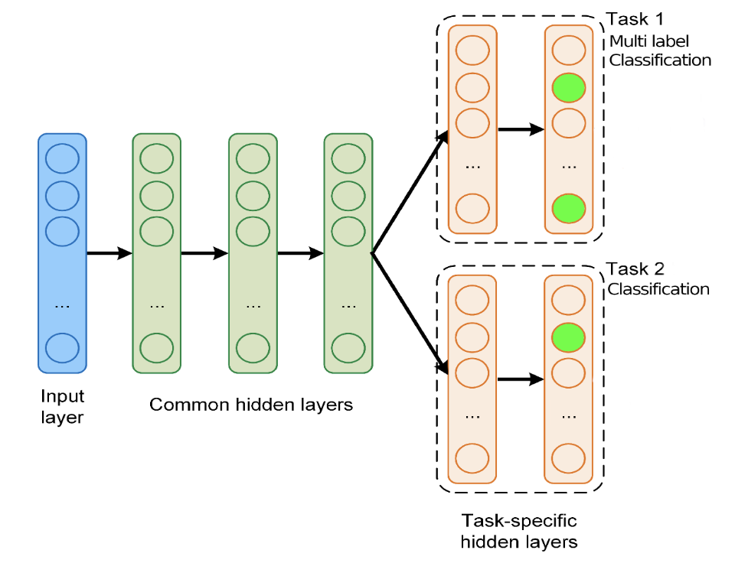
Literature Review 2: Integration of artificial neural network with finite element analysis for residual stress prediction of direct metal deposition process [2]
Innovative Integration
Multi-task labeling: The output label includes categorical and numerical data
Increasing number of outputs: Each xyz dimension has more 128 outputs to generate.
Future Prospects
Broad Application: Suitable for future physical models with number of small inputs vs. large number of outputs for multi-task labeling prediction.
Cost-Effective: Reduces the need for extensive physical prototyping, lowering development costs and accelerating production cycles.
[2] Hajializadeh, F., and A. Ince. "Integration of Artificial Neural Network with Finite Element Analysis for Residual Stress Prediction of Direct Metal Deposition Process." Materials Today Communications, vol. 27, 2021, p. 102197, doi:10.1016/j.mtcomm.2021.102197.
Notes:
However, in contrast, our model is further designed for multi-task labeling, which both includes categorical and numerical data, and each xyz dimension has more 128 outputs to generate. It also shows a broader application in the physical field.

Slide 9
Requirements and Specifications
Basic idea: Current finite element based websites are used as reference.
Requirements | Specifications | Target | Measurement
Accuracy | Predictive accuracy within 90% | ≥ 90% accuracy | Statistical analysis of prediction vs actual
Speed | Analysis time per simulation | ≤ 5 minutes | Time tracking software
Customization | Support diverse conditions | Handle 20+ variables | System configuration checks
Reliability | System operational uptime | 99.9% uptime | Server Monitoring tools
Notes:
Let's delve into the core of our project—the requirements and specifications that define our objectives.
Since now we already have a website perdicting the product damage based on fintie element analysis, we set this as reference, meaning that, what we do is to at least equivlant to or better than the function this web supports.
Our primary customer requirement is accuracy. The industry demands highly accurate predictions to minimize product damage during real life. This led us to establish an engineering specification that our predictions must achieve at least 90% accuracy under varying conditions.
Speed is another critical requirement. Our clients need quick results to make real-time decisions. Therefore, we've set a stringent specification that each analysis should be completed within five minutes. This ensures efficiency without compromising on the accuracy and reliability of our predictions.
User experience also plays a crucial role. Our platform is designed with an intuitive user interface that can handle multiple inputs seamlessly. It supports a broad range of box dimensions and material types, catering to the diverse needs of the industry. We've committed to supporting at least 20 different types of boxes, ensuring our platform's versatility.
Moreover, reliability is non-negotiable. We promise an operational uptime of 99.9%, underscoring our commitment to provide a dependable solution that our customers can trust day in and day out.
Each of these specifications was meticulously derived from our initial customer requirements using a Quality Function Deployment approach. This method helped us to better understand the project goal.

Slide 10
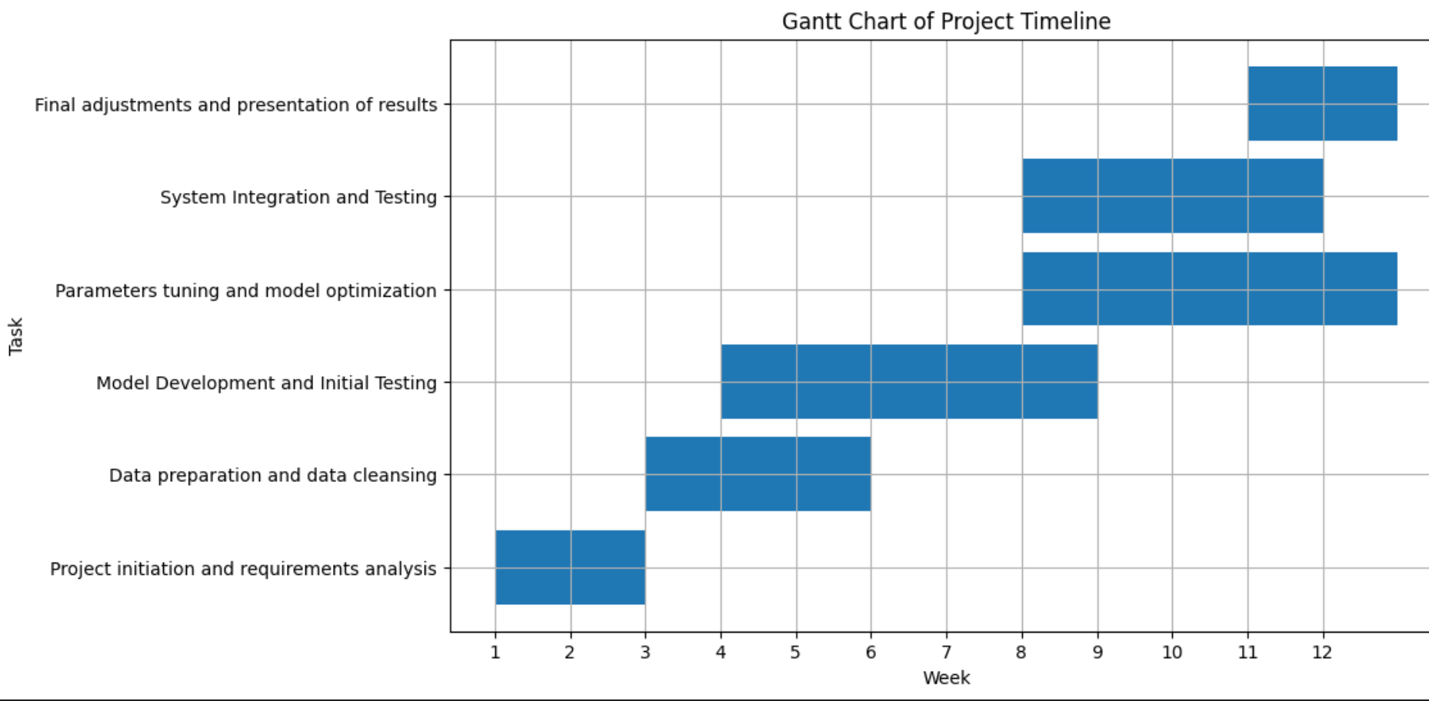
Project Schedule
Notes:
In the first two weeks, we will be initiating the project and analyzing requirements, which we have almost completed.
Moving into weeks three, we will concentrate on preparing the necessary data and conducting data cleansing. We will clean and preprocess this data to ensure it is of high quality, ready for use in our model development.
And from week4, we will start developing the initial Deep Neural Network model. After the initial construction of the modeling framework， we will train this model using the data we have prepared. We will also conduct preliminary tests to evaluate the model’s performance and accuracy. Based on these tests, we will try to adjust model parameters to optimize performance.
From week 8 till the end of the project, we will continue to focus on further optimizing the DNN model, which involves tuning hyperparameters and using cross-validation techniques to enhance model accuracy. If possible, we will compare its performance with that of the traditional FEA model to validate our model’s effectiveness.
At the same time, we will try to integrate our DNN model into the DrBoxOnline.com platform. We will perform some system integration test to ensure compatibility between the model and the platform.
Finally, in week twelve, we will summarize our project outcomes and showcase our progress and achievements to stakeholders.

Slide 11
Q&A

Slide 12
THANK YOU！

